Slide 1

Capstone Project – Term II Code - 2005
Saurav Bisht
100850875

Slide 2
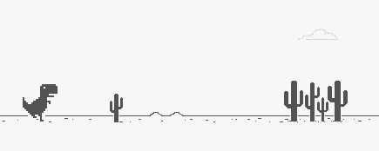
T-rex Dinosaur Bot
It starts where internet ends

Slide 3

Aim of the Project
Understanding the concepts behind Reinforcement learning, developing basics of game design and development and finally, understanding the logical reasoning behind the idea of reward and loss strategy for implementation.
Development Stages of Project
To develop Dino Game
To implement three-way difficulty level for user
To develop a bot for the game
To implement Reinforcement Learning

Slide 4




Where is the game?
The game will be designed and developed from scratch
Environment used – VS CODE - under Virtual pip env
Language – Python
Assets – Will be created using Adobe Illustrator
Music – Open-source websites
Main Python module - Pygame

Slide 5
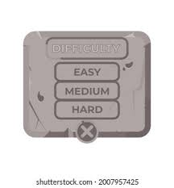
Stages of Difficulty in game
The gameplay of the game will be based on three stage difficulty level
It will depend on the number of obstacles in the game
First Stage: Will require user to use jump feature for avoiding obstacles
Second Stage: Will require user to jump and duck to avoid obstacle
Third Stage: Will require user to jump, duck and long jump to avoid obstacle

Slide 6
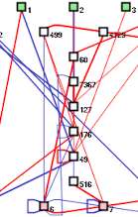
Implementing Reinforcement Learning
Library - NEAT( Neuro-Evolution of Augmenting Topologies )
What is Neat? - Kenneth O. Stanley created this method for developing arbitrary neural networks
Will be implanted in two way:
First – User plays the game, while the algorithm learns to play the game using the gameplay of the user
Second – Bot Learns to play game on itself, based on the strategy of rewards and loss

Slide 7



Deployment Stage
The game will be available to play on download through website
Website Frontend – Will be designed in Flutter Environment
Language – Dart
Hosting - On Heroku

Slide 8
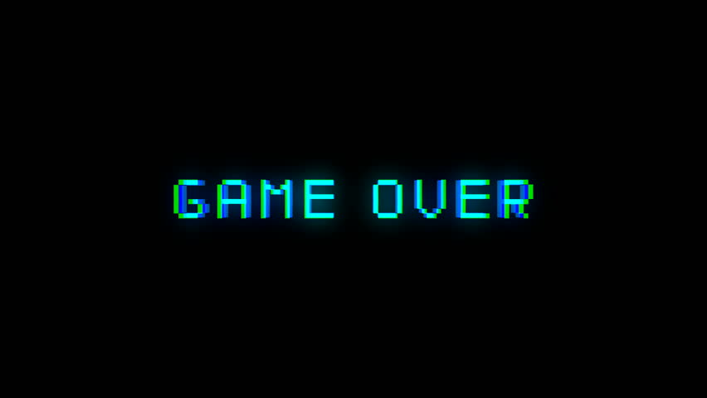
Thank You

